Slide 1

CT Scan Reconstructor
Simplified Linear Algebra Simulation
x → A → b = Ax → Rank/Nullity → Least Squares → x̂

Slide 2
Topic 1 — What is the project?
We simulate the basic mathematical idea behind CT reconstruction.
1. Hidden object
A CT scanner wants information about what is inside an object/body.
2. Measurements
X-rays pass through from different directions and produce measurements.
3. Reconstruction
Use those measurements to estimate the internal image.
Our simplified demo
We use a small 8×8 test object instead of a real patient scan so the linear algebra is easy to see.

Slide 3
Topic 1 — Our simple 8×8 test object
Each small square is one pixel/value.
Why a square?
It makes every measurement easy to understand and calculate.
Pixel values
0 = black/background • 1 = white/object
Theory
8 × 8 = 64 pixel values. These are the unknowns we later try to reconstruct.
OUTPUT → 8×8 test image

Slide 4
Topic 2 — Image → vector x
Linear algebra represents the image as numbers in a vector.
Flatten the image
Write all 64 pixel values one after another.
What is x?
x is the mathematical representation of the image we want to recover.
x = 64 × 1
Nothing is lost
The 8×8 layout changes into a vector, but the same 64 values are still present.

Slide 5
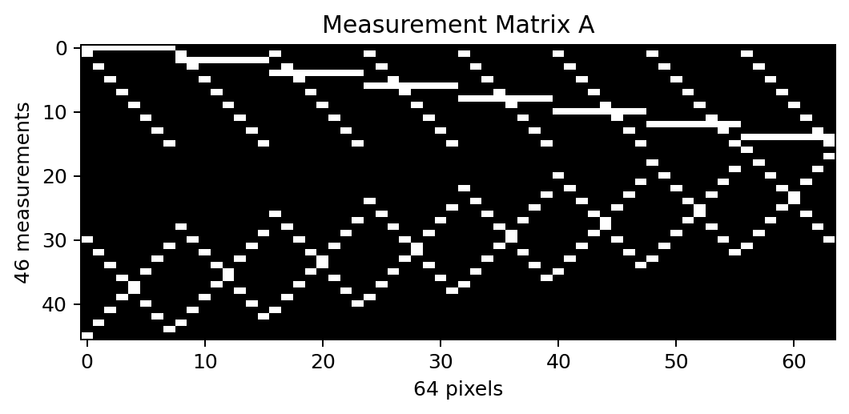
Topic 2 — Measurement matrix A
A describes how our simulated scan takes line measurements.
Each row
one line measurement
Each column
one of the 64 pixels
Lines used
horizontal + vertical + diagonal directions
A = 46 × 64

Slide 6
Topic 3 — Simulated scan: b = Ax
This is the main equation of our project.
A
Which pixels does each scan line use?
x
What value does each pixel have?
b
What line measurement is produced?
b = A x
Dimensions
(46 × 64) × (64 × 1) = (46 × 1) → b contains 46 measurements.

Slide 7
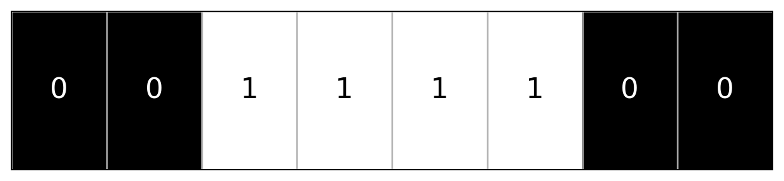
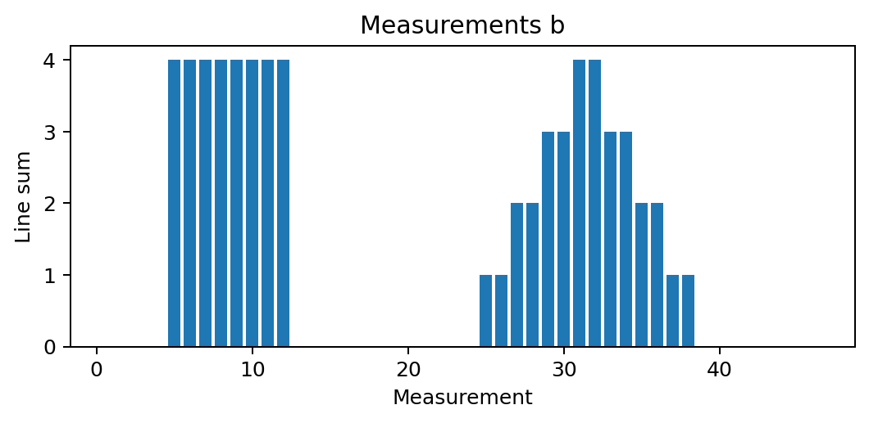
Topic 3 — One measurement, visually
A line measurement is simply the sum of the pixel values it crosses.
Line crosses
0, 0, 1, 1, 1, 1, 0, 0
Add them
0 + 0 + 1 + 1 + 1 + 1 + 0 + 0 = 4
One value of b = 4
OUTPUT
Repeat for all lines → b = 46×1.

Slide 8
Topic 4 — Rank
How much independent information is present in A?
RANK — simple meaning
Rank tells us how much independent/useful information our measurement matrix contains.
Why not 46?
We have 46 measurements, but some contain overlapping/dependent information. So only 39 are independent in this model.
Rank(A) = 39
Theory
More measurements do not automatically mean the same number of independent pieces of information.

Slide 9
Topic 4 — Nullity & underdetermined system
This explains why reconstruction is not a simple exact reversal.
NULLITY
Information that is not uniquely determined by the measurements.
UNDERDETERMINED
We have 64 unknown pixel values but only 39 independent pieces of information.
SO WHAT?
There is not one obvious unique x. We need a suitable estimate.
64 − 39 = 25
NEXT → Least Squares
OUTPUT
Rank = 39, Nullity = 25 → system is underdetermined.

Slide 10
Topic 5 — Least Squares
We now try to reconstruct the unknown image using only A and b.
WHAT WE HAVE
A = how the line measurements were taken
b = the 46 measurements obtained
WHAT WE WANT
Recover the unknown 64 pixel values of x.
OUR ESTIMATE
The reconstructed vector is called x̂ (x-hat).
A x̂ ≈ b
Why Least Squares?
A is 46×64 and the system is underdetermined, so we cannot simply invert A to get one unique x.
Simple meaning
Least squares chooses a suitable x̂ whose predicted measurements A x̂ agree with b as closely as possible.
OUTPUT → x̂ = 64 × 1 estimated pixel values

Slide 11

Topic 5 — From x̂ to the final reconstructed image
For our square input, the final step converts the estimated values back to clear 0s and 1s.
2. LEAST-SQUARES RESULT
x̂ contains estimated pixel values. Because the system is underdetermined, some values appear grey instead of exactly 0 or 1.
3. THRESHOLD → FINAL
Our test object is binary. So values > 0.5 become 1 (white), and values ≤ 0.5 become 0 (black).
1. ORIGINAL TEST OBJECT
Known only for checking whether our reconstruction worked.
8 × 8 square
raw reconstructed x̂
final 8 × 8 image
FINAL RESULT → reconstructed square matches the original

Slide 12
Complete project flow
Each topic produces the input needed by the next topic.
TOPIC 1
8×8 image
TOPIC 2
x + A
TOPIC 3
b = Ax
TOPIC 4
Rank + Nullity
TOPIC 5
x̂ → image
One-line story
Represent the object as x → simulate line measurements with A → obtain b → study information using rank/nullity → estimate x using least squares → reconstruct the image.

Slide 13
Vanshika kakumanu
PES1UG25AM437
Srujana S Ravi
PES1UG25AM407
Sinchana M
PES1UG25AM396
Tanisha Patro
PES1UG25AM423
Thushara Lakshmi N
PES1UG26AM821

